Slide 1
CSET301 – AI-ML
Lecture 4 : Gradient Descent

Slide 2
Outline
Gradient Descent Algorithm
First order derivatives
Linear regression using gradient descent
Learning rate

Slide 3
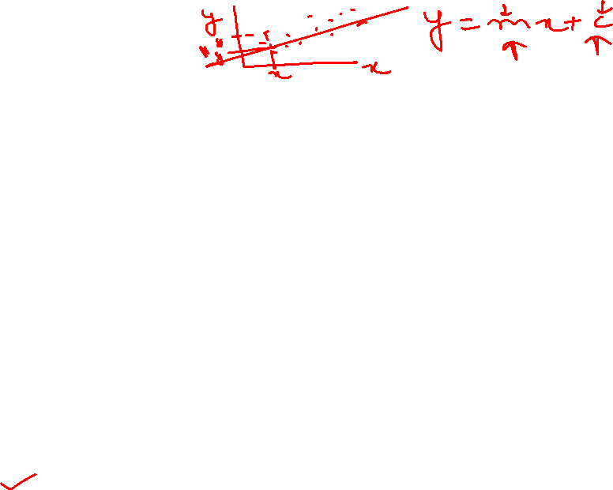
Terms used in ML
Optimization: Refers to process of adjusting the parameters of a model to minimize (or maximize) an objective function.
Objective function: General term for any function to be optimized in mathematical optimization problem. Measures how well the model performs on a task: such as minimizing the error on a set of training data.
There are various optimization algorithms used in machine learning to find the optimal set of parameters. These algorithms are responsible for updating the model parameters iteratively during the training process.
One such optimization method is Gradient Descent

Slide 4
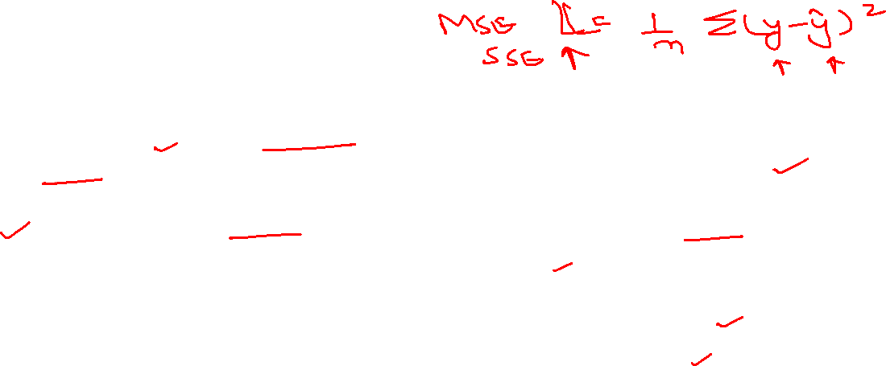
Terms used in ML
Gradient Descent is an iterative optimization algorithm used to find the minimum of a function. In ML, it is used for training models by adjusting parameters.
Cost function (or Loss function) quantifies the error of a model's predictions. The goal of gradient descent is to minimize this function.
Note: In ML, loss functions quantify the error on a single training example, while cost functions represent the average error across the entire training dataset. Essentially, the cost function aggregates the losses from individual data points.

Slide 5
Gradient Descent
Gradient descent is a first-order (rely on first derivative) iterative optimization algorithm to find the minimum of a cost/loss function by iteratively adjusting the parameters of a model.
Think of a gradient as a slope—just like how steep a hill is. In math, it tells you how fast and in which direction something (like error or loss) is changing.

Slide 6
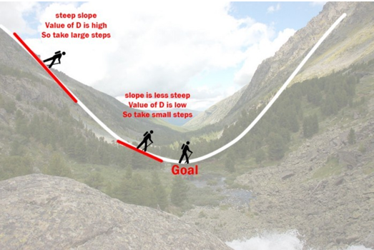
Understanding Gradient Descent

Slide 7
Gradient Descent
Imagine a valley and a person with no sense of direction who wants to get to the bottom of the valley.
He goes down the slope and takes large steps when the slope is steep and small steps when the slope is less steep.
He decides his next position based on his current position and stops when he gets to the bottom of the valley which was his goal.

Slide 8
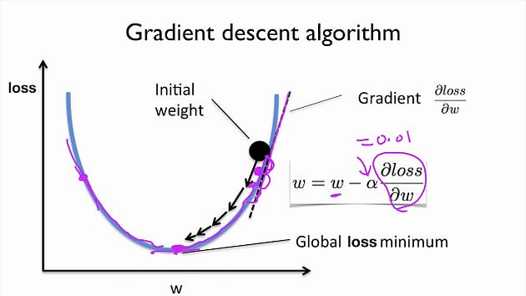
Gradient Descent
Primary purpose: Minimize cost function by iteratively adjusting the parameters (weights) of a model.
Steps:
Start with an initial set of weights.
In each iteration, compute the gradient of the loss function wrt w
α is the learning rate

Slide 9
Gradient Descent
δloss​/δw: Gradient of the loss function. Represents the rate of change of the loss wrt. the weight parameter.
The goal is to adjust the weights in the direction that minimizes the loss, and the derivative provides information about the slope of the loss function at a specific point in the parameter space.

Slide 10
Gradient Descent for linear regression
In linear regression, we aim to find the line that best represents the relationship between variables. This line is defined by its slope and intercept. Finding the optimal values for these parameters is crucial for accurate predictions.
Gradient descent is used in linear regression to find the line of best fit by iteratively minimizing the difference between predicted and actual values.

Slide 11
Gradient Descent for linear regression
The Gradient Descent Approach:
Start with an initial guess: We begin with random values for the slope and intercept.
Calculate the gradient: We compute the gradient/derivative of the cost function, Gradient indicates the direction in which the cost function is increasing.
Take a step in the opposite direction: To minimize the cost, we move the slope and intercept in the opposite direction of the gradient. The size of the step is determined by the learning rate (a hyperparameter).
Repeat: We repeat the gradient calculation and update steps until the cost function reaches a minimum (or a satisfactory low value).

Slide 12
Gradient Descent for linear regression
Linear regression:
y = mx + c
Let’s apply Gradient Descent to m and c and approach it step by step:–
Initially let m = 0 and c = 0.
Let L be our learning rate. This controls how much the value of m changes with each step. L could be a small value like 0.0001 for good accuracy.
Calculate the partial derivative of the loss function with respect to m, and plug in the current values of x, y, m and c in it to obtain the derivative value D.

Slide 13



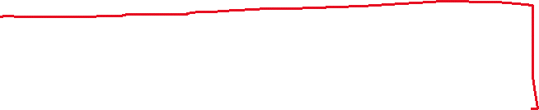


Gradient Descent for linear regression
Lets say our loss function l is MSE:
Derivative wrt m, D_{m}:

Slide 14

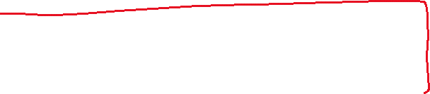


Gradient Descent for linear regression
Derivative wrt c, D_{c}:

Slide 15
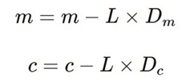
Gradient Descent for linear regression
Now we update the current value of m and c using the following equation:
We repeat this process until our loss function is a very small value or ideally 0 (which means 0 error).
The value of m and c that we are left with now will be the optimum values.

Slide 16
Gradient Descent for linear regression
Now going back to our analogy of person going down the hill:
m can be considered the current position of the person.
D is equivalent to the steepness of the slope and
L can be the speed with which he moves.
Now the new value of m that we calculate using the above equation will be his next position, and L×D will be the size of the steps he will take.
When the slope is more steep (D is more) he takes longer steps and when it is less steep (D is less), he takes smaller steps.
Finally he arrives at the bottom of the valley which corresponds to our loss = 0. Now with the optimum value of m and c our model is ready to make predictions !

Slide 17
Gradient Descent for linear regression
Why Gradient Descent for Linear Regression?
Computational Efficiency: When dealing with large datasets, especially with many features, gradient descent can be more computationally efficient than calculating the closed-form solution directly.
Iterative Improvement: Gradient descent allows for incremental improvement. We can see how each step affects the cost and adjust our approach accordingly.
General Applicability: Gradient descent is a versatile algorithm that can be applied to various machine learning models, not just linear regression.

Slide 18
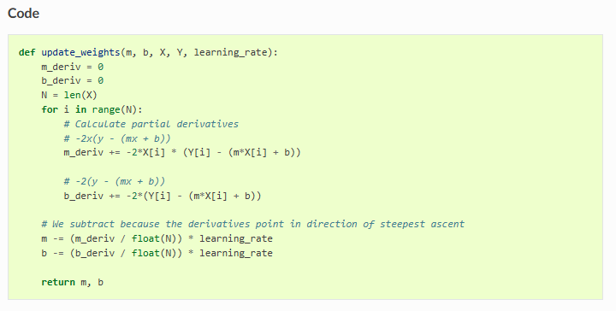
Gradient Descent for linear regression: Code

Slide 19
Gradient Descent: Reading reference
https://ml-cheatsheet.readthedocs.io/en/latest/gradient_descent.html
Gradient Descent Visualization: https://www.youtube.com/watch?v=IHZwWFHWa-w

Slide 20
Thank You

